Slide 1
MUSIC HOST INTERFACE
BEng. Hons. Computer And Electronic Engineering, GMIT
Student: Thomas Flynn
Supervisor: Brian O’ Shea

Slide 2
Contents
Background
Development
Desktop Media Player Application
Android Application
Summary
Conclusion

Slide 3
Background & Scoping
Personal
Demonstrate Abilities
Realization of Ideas
Initial Idea
Virtual Jukebox
Complete Idea
Music Host dictates what the guests can do.
The guest can...
-Request songs
-Skip songs
-Give the DJ feedback

Slide 4
Tools
JavaFX
Scene Builder 2.0
Media Player API
Animation API
Microsoft Azure Cloud Storage
User Login Credentials
User Songs
Bluetooth
BlueCove library
Android Bluetooth API

Slide 5
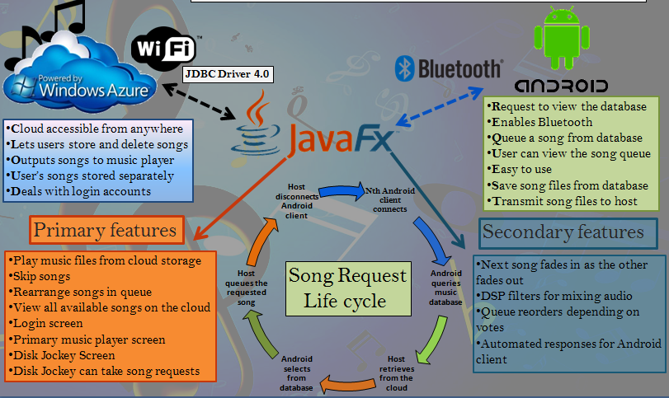
Christmas Poster

Slide 6
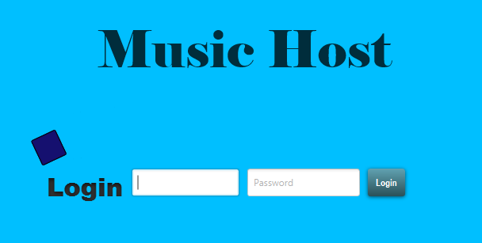
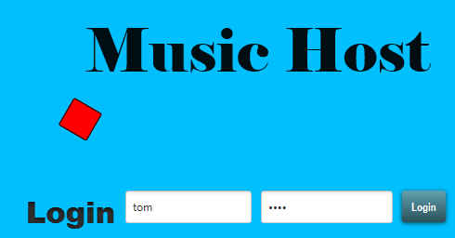
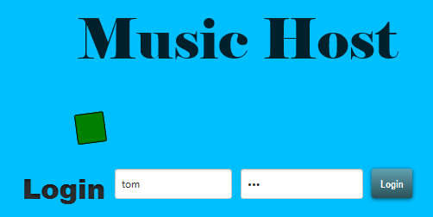
LOGIN SCREEN
Login Credentials
Success/Fail
Animation
Login Button
Fail
Animation
Success
Animation

Slide 7
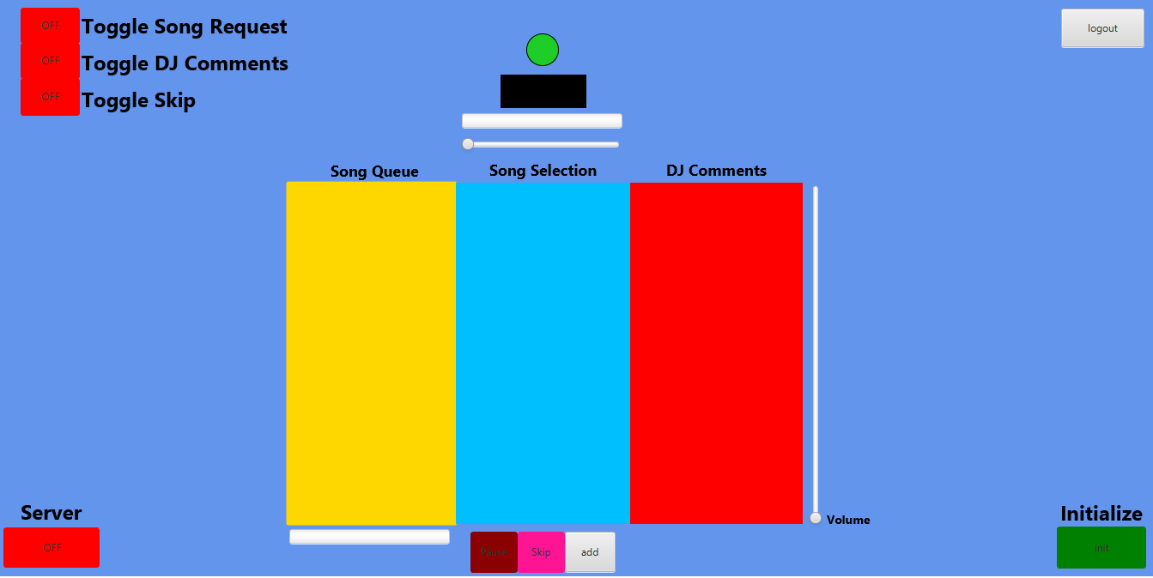
MAIN SCREEN
Host Options
Logout Button
MediaView
Play Animation
Time Slider
Server Button
Download
Progress
Play, Skip, Add, Buttons
Volume Control
Start Button

Slide 8
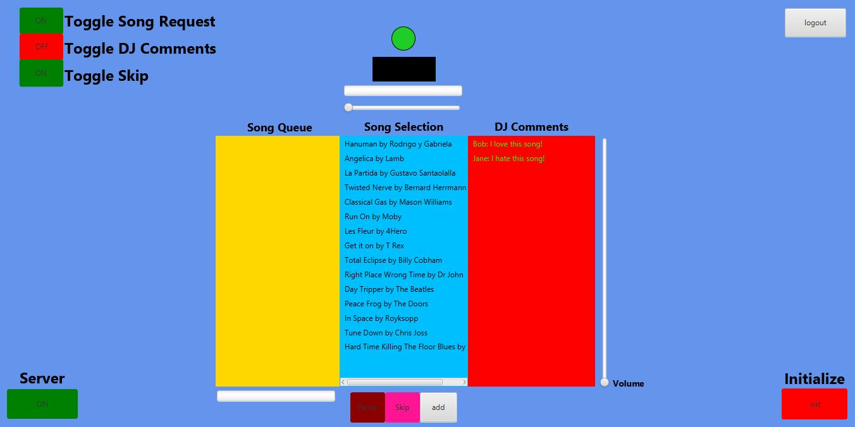
USE CASE – SETUP
Guest Options Specified
Server Enabled
Selection Populated
Initialized

Slide 9
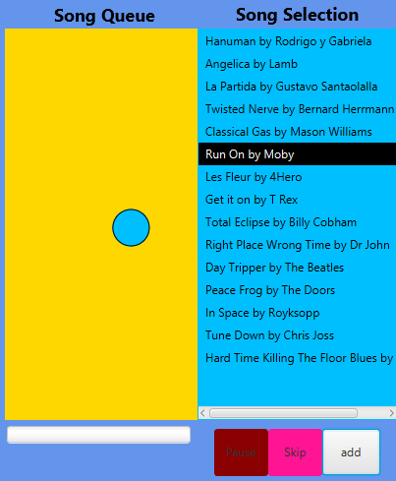
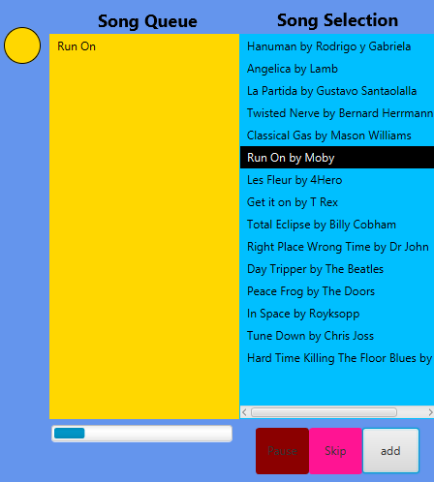
USE CASE - SONG ADDED
Animation Complete
Song added
Animation
Download Started
User Clicks

Slide 10
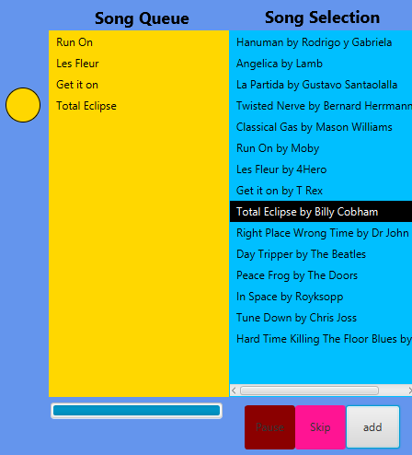
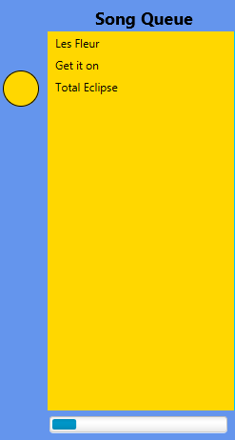
USE CASE - SONG SKIPPED / SONG ENDED
Event Fired

Slide 13
Conclusion
Goals
Demonstration of abilities
Experience with Invention
Introduced to new APIs, tools and methodologies
Reflection
More focus on control methods
Develop more synchronization with user
My conclusion
Project is a product of my abilities and personality
Realisation will never be what you expect

Slide 14
Experiments
Test Practicality and Usability of Application
Developing a purpose
Directions the application could have took
Adding Gameplay Mechanics
Application as a Game
Feasibility and Entertainment tests
Midi Instrument
If the application had been midi based
Usability as an instrument

Slide 15
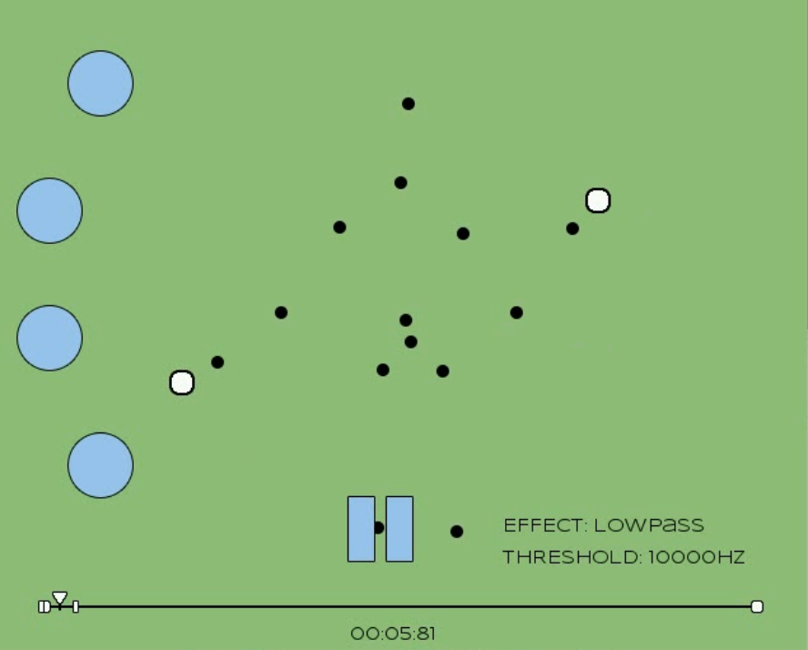
Experiment 1 – Gameplay Mechanics
Looping Track Sections
Turn on effect to break
Feasibility
Mechanics functional
Application operational
Entertainment
Not in sync with tracks
Conclusion
Difficult to link mechanics

Slide 16
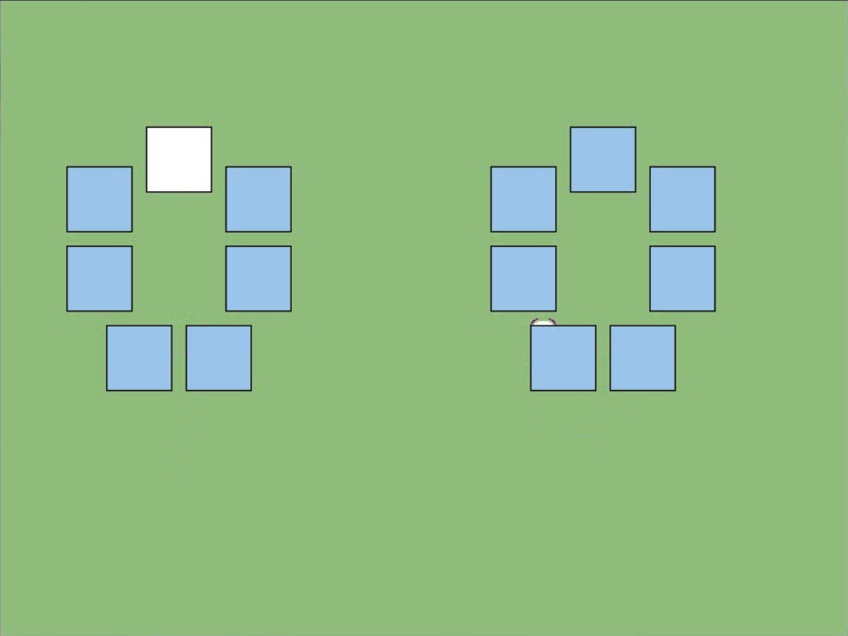
Experiment 2 – Midi Instrument
Kinect Midi Generator
Instrumentation
Usability
Lack of control resolution
Reduction of inputs
Conclusion
Compensation of control
Reduction of playability

Slide 17
References
KinectSDKBook4CPP – github
Channel9 MSDN Kinect Tutorials
Focus On SDL – Ernest Pazera
FMOD Ex Examples and Documentation
Freshfunkee.wordpress.com
Github.com/freshfunkee
Youtube.com/ejoy50

